Slide 1

Operating systems
I/O Management, System Protection and Security
Venkatesh Prasad
Department of Computer Science

Slide 2
Operating systems
I/O Hardware, polling and interrupts
Venkatesh Prasad
Department of Computer Science
Notes:
Explore the structure of an operating system’s I/O subsystem
Discuss the principles of I/O hardware and its complexity
Provide details of the performance aspects of I/O hardware and software

Slide 3
OPERATING SYSTEMS
Slides Credits for all PPTs of this course
The slides/diagrams in this course are an adaptation, combination, and enhancement of material from the following resources and persons:
Slides of Operating System Concepts, Abraham Silberschatz, Peter Baer Galvin, Greg Gagne - 9th edition 2013 and some slides from 10th edition 2018
Some conceptual text and diagram from Operating Systems - Internals and Design Principles, William Stallings, 9th edition 2018
Some presentation transcripts from A. Frank – P. Weisberg
Some conceptual text from Operating Systems: Three Easy Pieces, Remzi Arpaci-Dusseau, Andrea Arpaci Dusseau

Slide 4
OPERATING SYSTEMS
Overview
I/O management is a major component of operating system design and operation
Important aspect of computer operation
I/O devices vary greatly
Various methods to control them
Performance management
New types of devices frequent
Ports, buses, device controllers connect to various devices
Device drivers encapsulate device details
Present uniform device-access interface to I/O subsystem

Slide 5
OPERATING SYSTEMS
I/O Hardware
Incredible variety of I/O devices
Storage (Disks, tapes)
Transmission (network connections, Bluetooth)
Human-interface (screen, keyboard, mouse, audio in and out)
Common concepts – signals from I/O devices interface with computer
Port – connection point for device
Bus - daisy chain or shared direct access
PCI bus common in PCs and servers, PCI Express (PCIe)
expansion bus connects relatively slow devices
Controller (host adapter) – electronics that operate port, bus, device
Sometimes integrated
Sometimes separate circuit board (host adapter)
Contains processor, microcode, private memory, bus controller, etc
Some talk to per-device controller with bus controller, microcode, memory, etc
Notes:
The hardware mechanism that enables a device to notify the CPU is called an interrupt

Slide 6
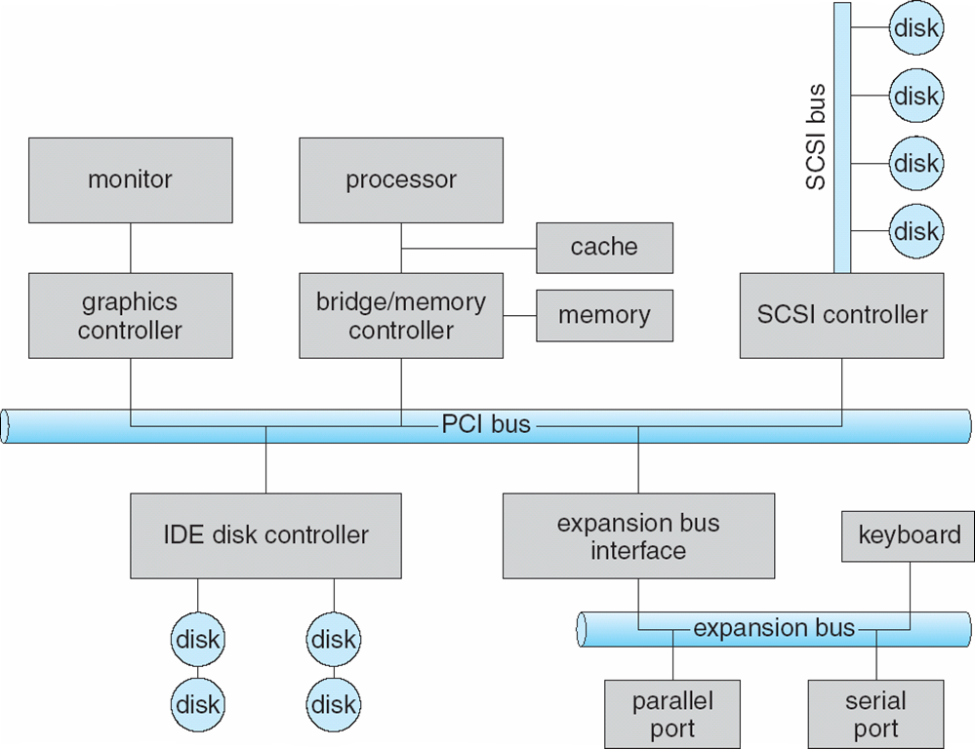
OPERATING SYSTEMS
A Typical PC Bus Structure
Notes:
PCI bus (the common PC system bus) connects the processor–memory subsystem to fast devices, and
an expansion bus connects relatively slow devices, such as the keyboard and serial and USB ports.
Four disks are connected together on a Small Computer System Interface (SCSI) bus plugged
into a SCSI controller.
SCSI bus controller typically contains a processor, microcode, and some private memory to enable
it to process the SCSI protocol messages.

Slide 7
OPERATING SYSTEMS
I/O Hardware
I/O instructions control devices
Devices usually have registers where device driver places commands, addresses, and data to write, or read data from registers after command execution
Data-in register, data-out register, status register, control register
Typically 1-4 bytes, or FIFO buffer

Slide 8
OPERATING SYSTEMS
I/O Hardware (Cont.)
Devices have addresses, used by
Direct I/O instructions
Special I/O instructions specify the transfer of a byte or word to an I/O port address.
The I/O instruction triggers bus lines to select the proper device and to move bits into or out of a device register.
Memory-mapped I/O
Device data and command registers mapped to processor address space
Especially for large address spaces (graphics)
Some systems use both techniques – I/O instructions to control some devices and memory-mapped I/O to control others

Slide 9
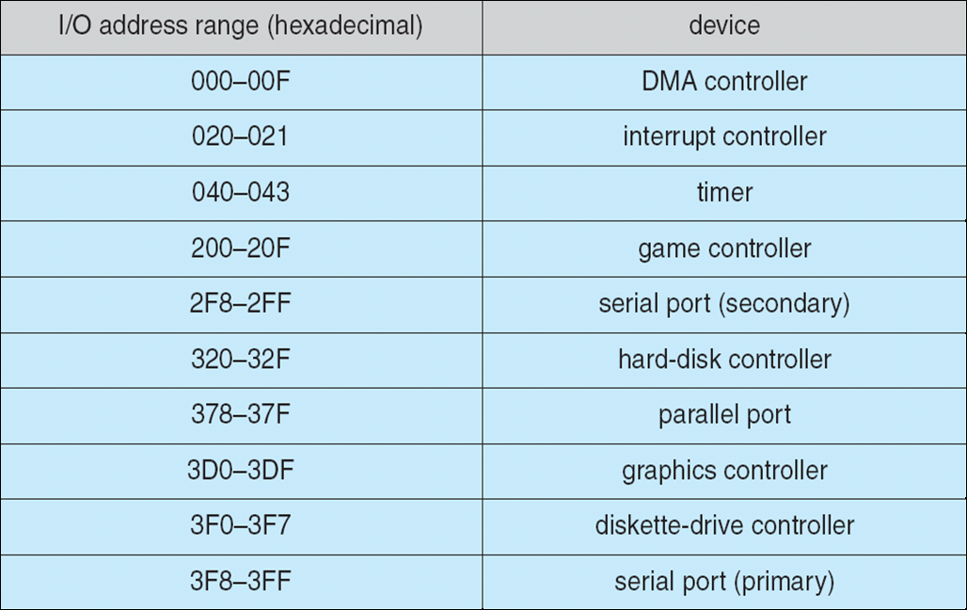
OPERATING SYSTEMS
Device I/O Port Locations on PCs (partial)

Slide 10
OPERATING SYSTEMS
Polling
For each byte of I/O
Host repeatedly reads busy bit from status register until that bit becomes clear (here host is busy-waiting or polling)
Host sets read or write bit and if write, copies data into data-out register
Host sets command-ready bit
Controller notices command-ready bt is set, sets busy bit, executes transfer
Controller clears busy bit, error bit, command-ready bit when transfer done
Step 1 above is busy-wait cycle to wait for I/O from device
Reasonable if device is fast
But inefficient if device slow
CPU switches to other tasks?
But if miss a cycle data overwritten / lost

Slide 11
OPERATING SYSTEMS
Interrupts
Polling can happen in 3 instruction cycles
Read a device register, logical--and to extract status bit, branch if not zero
How to be more efficient if non-zero infrequently?
CPU Interrupt-request line triggered by I/O device
Checked by processor after each instruction
Interrupt handler receives interrupts
Maskable to ignore or delay some interrupts
Interrupt vector to dispatch interrupt to correct handler
Context switch at start and end
Based on priority
Some nonmaskable
Interrupt chaining (list of interrupt handlers) if more than one device at same interrupt number
Above features are provided by the CPU and by the Interrupt-controller hardware
Most CPUs have 2 interrupt request lines – maskable and nonmaskable

Slide 12
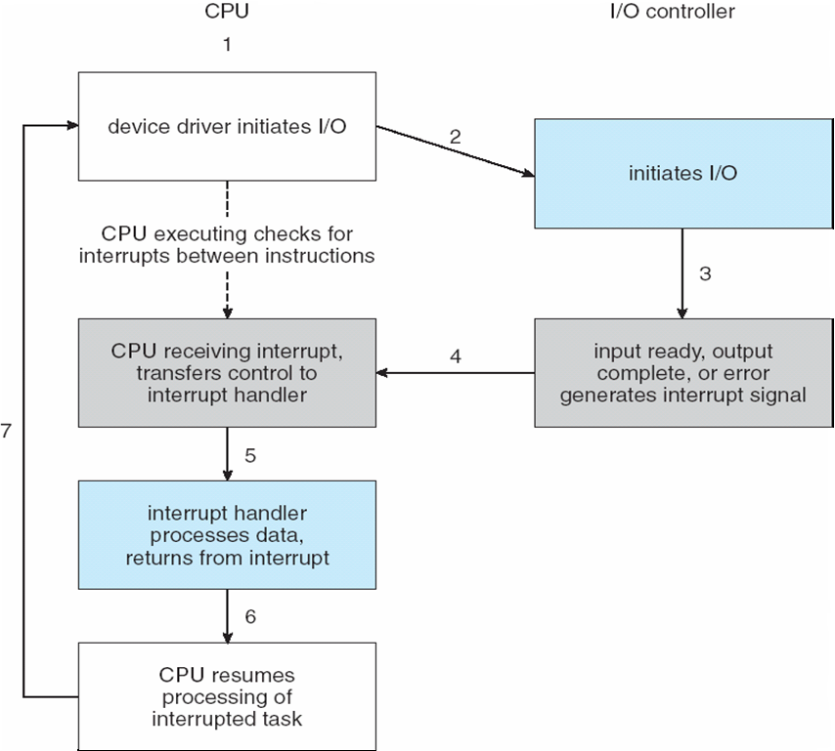
OPERATING SYSTEMS
Interrupt-Driven I/O Cycle
At boot time, OS probes the hardware buses to determine the devices present and installs the corresponding interrupt handlers into the interrupt vector

Slide 13
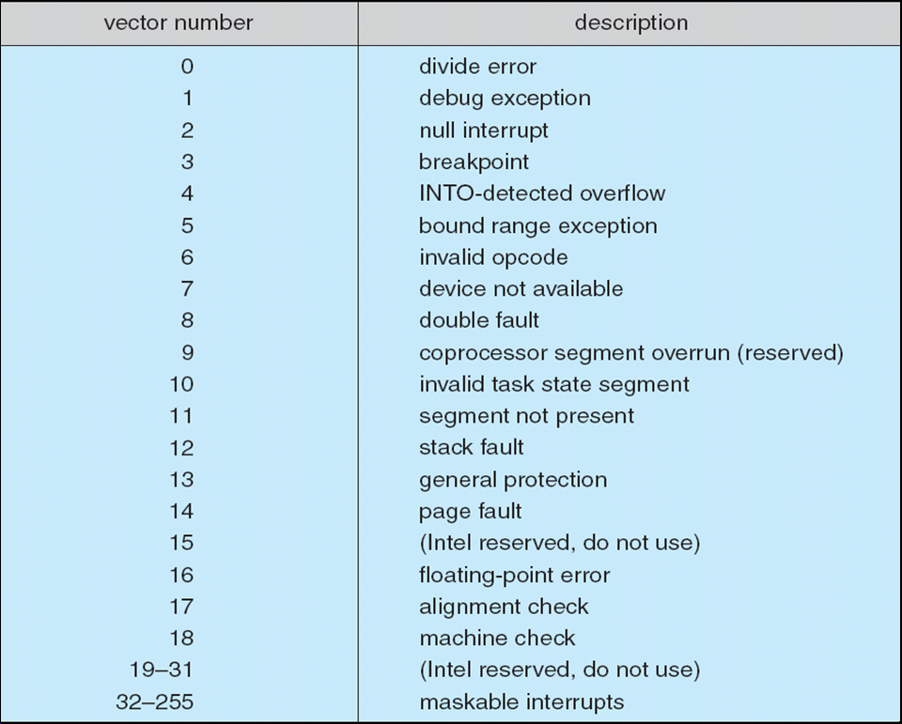
OPERATING SYSTEMS
Intel Pentium Processor Event-Vector Table
Events from 0 to 31 are nonmaskable and are used to signal various error conditions

Slide 14
OPERATING SYSTEMS
Interrupts (Cont.)
Interrupt mechanism also used for exceptions
Terminate process, crash system due to hardware error
Page fault executes when memory access error
System call executes via trap to trigger kernel to execute request
Software interrupt or trap is given a lower priority compared to device interrupts
Multi-CPU systems can process interrupts concurrently
If operating system designed to handle it
Used for time-sensitive processing, frequent, must be fast
Note: Interrupt handlers in Solaris are executed as kernel threads

Slide 15

THANK YOU
Venkatesh Prasad
Department of Computer Science Engineering
venkateshprasad@pes.edu

